Slide 1
Visual Rhetoric
A Brief-ish Introduction

Slide 2
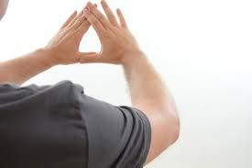
Visual What?
Visual Literacy:
The ability to interpret and make meaning from information presented in the form of an image
Based on the idea that pictures can be “read” and that meaning can be communicated through them
Visual Rhetoric:
The use of images to communicate
Focuses specifically on the ability of images to persuade
Be visually literate
so that you can understand visual rhetoric.

Slide 3
What is Media?
Definition of Media:
any form of mass communication
Documentaries
Movies
News
Talk Shows
Commercials
Billboards
Television
Facebook
Twitter
Political Cartoons
Magazines
Advertisements
Radio Shows
Statues
Memorials
Bumper Stickers
Stamps
Product Packaging
And More!!!!!!!!!!!!!!!!!!!!!!!!!!!!!!!!!!!!!!!!!

Slide 4
Why We Care about MEDIA in AP LANG
All media messages are constructed.
All media messages contain embedded values and points of view.
People use their individual skills, beliefs, and life experiences to construct meaning from media messages.
All media and media messages are rhetorical:
They are produced for particular purposes.
They can influence beliefs, attitudes, values, behavior, and even the democratic process!

Slide 5
Commenting on Visual Rhetoric: The Visual Precis
Put into words the literal subject matter of the visual.
Ask yourself: What do I actually see?
Describe the details of the image that are being used to create a message.
Ask yourself: What specific things are happening in the visual and to what purpose?
Explain the rhetorical devices and strategies being used in this image.
Ask yourself: What is the significance of the details I see, and how do they relate to the issue begin commented upon?
State the interpretation of the visual as a whole.
Ask yourself: What reaction is the image attempting to foster in me?

Slide 6
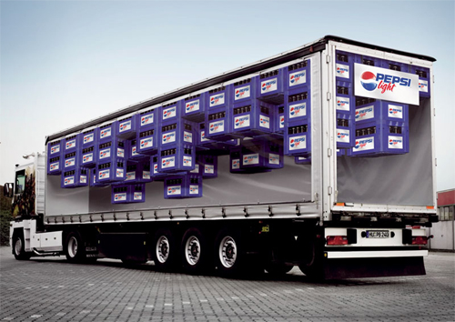

Slide 7
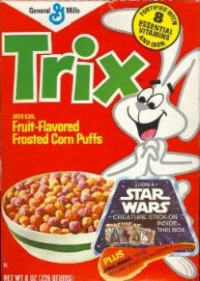

Slide 8
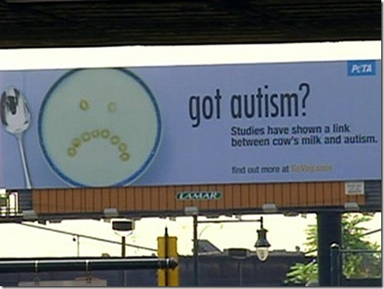

Slide 9
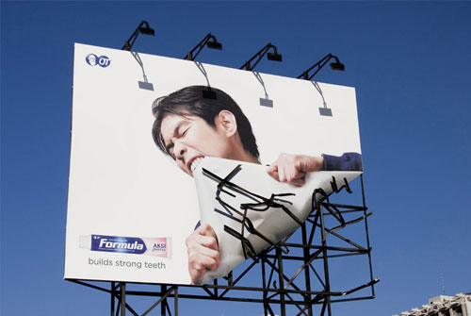

Slide 10
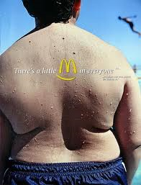

Slide 13
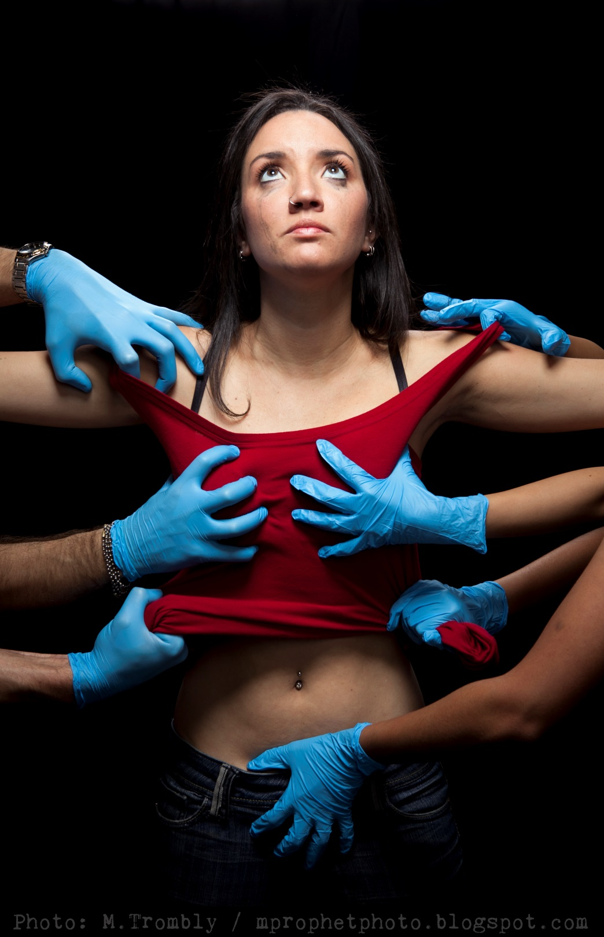

Slide 15
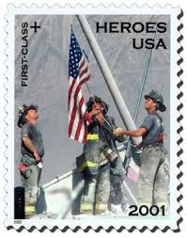

Slide 16
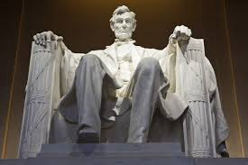

Slide 17
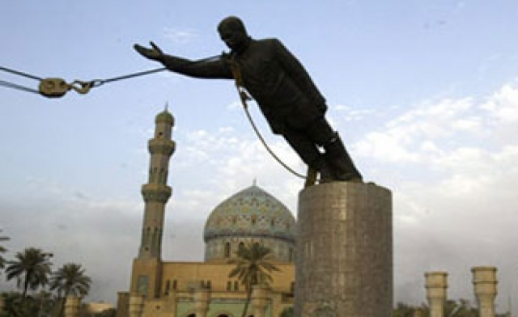

Slide 18
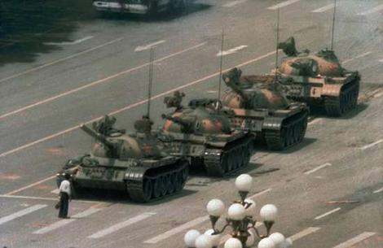

Slide 19
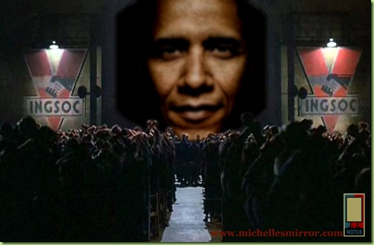

Slide 20
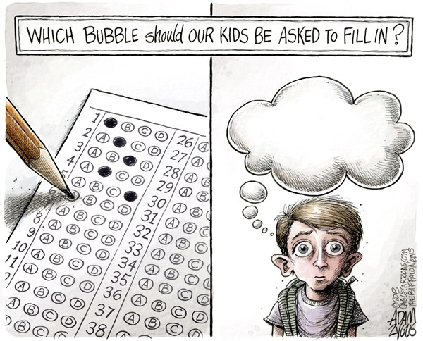

Slide 21
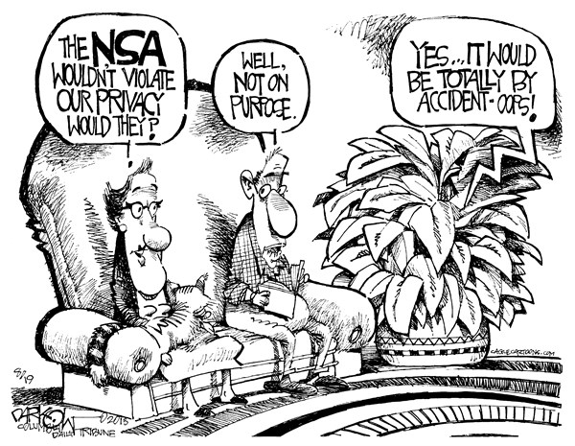

Slide 22
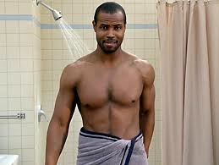
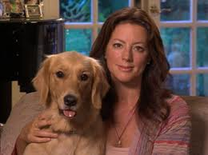
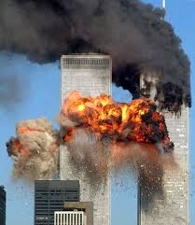
And Finally-ish
Old Spice
Oh, Sarah
An Explanation for 9/11?

Slide 23
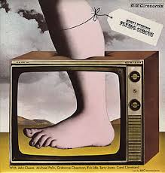
And lastly for real, for something completely mind-blowing…
Visual Rhetoric About Argumentation. WHA???
Monty Python's Witch Trial
Monty Python's Argument Clinic

